Slide 1
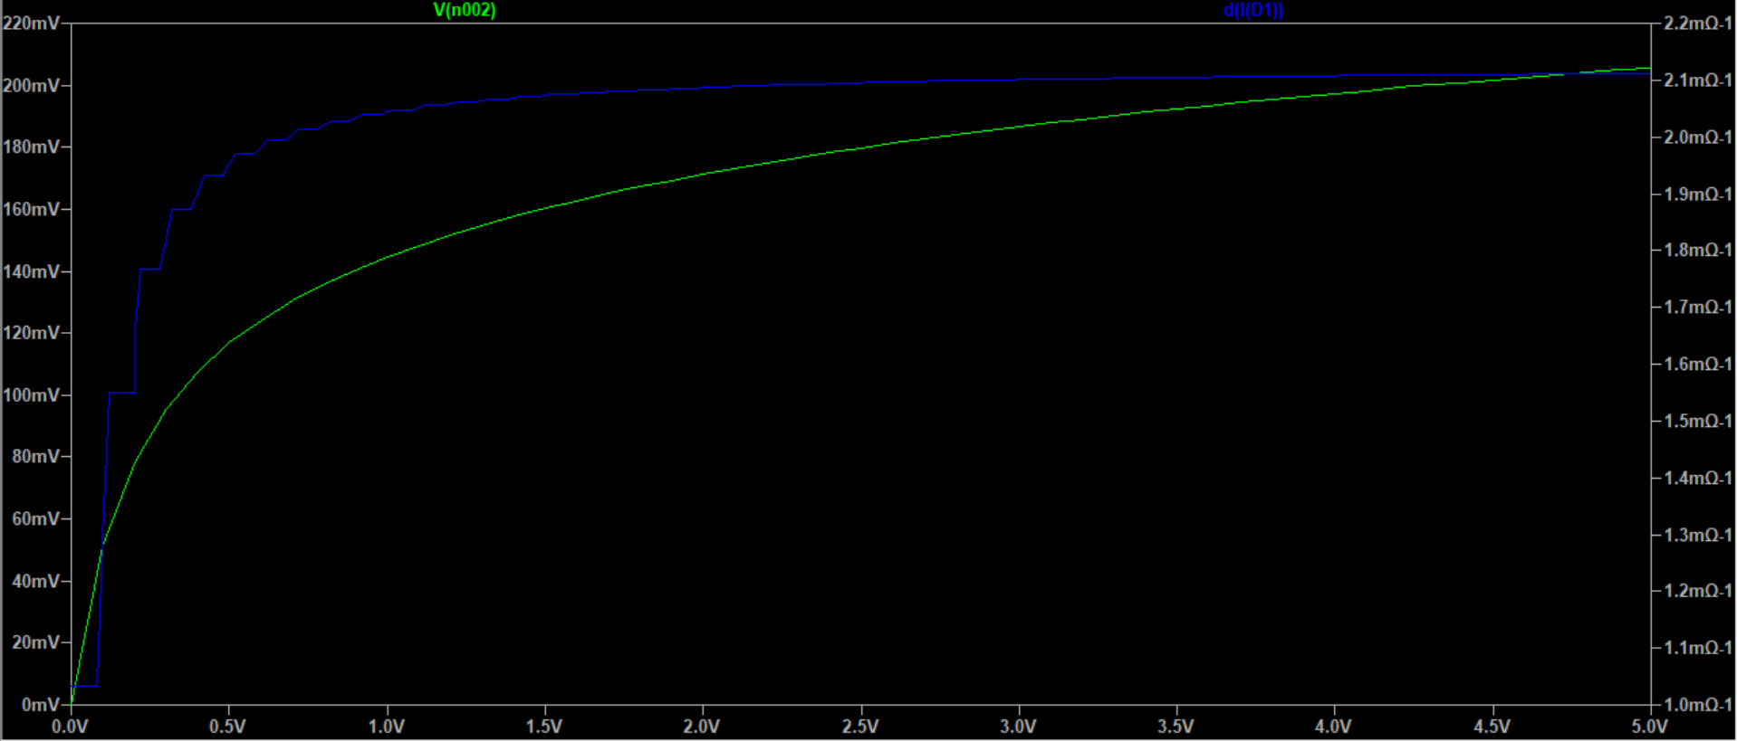
Exercise E4
aaaaaaa

Slide 2
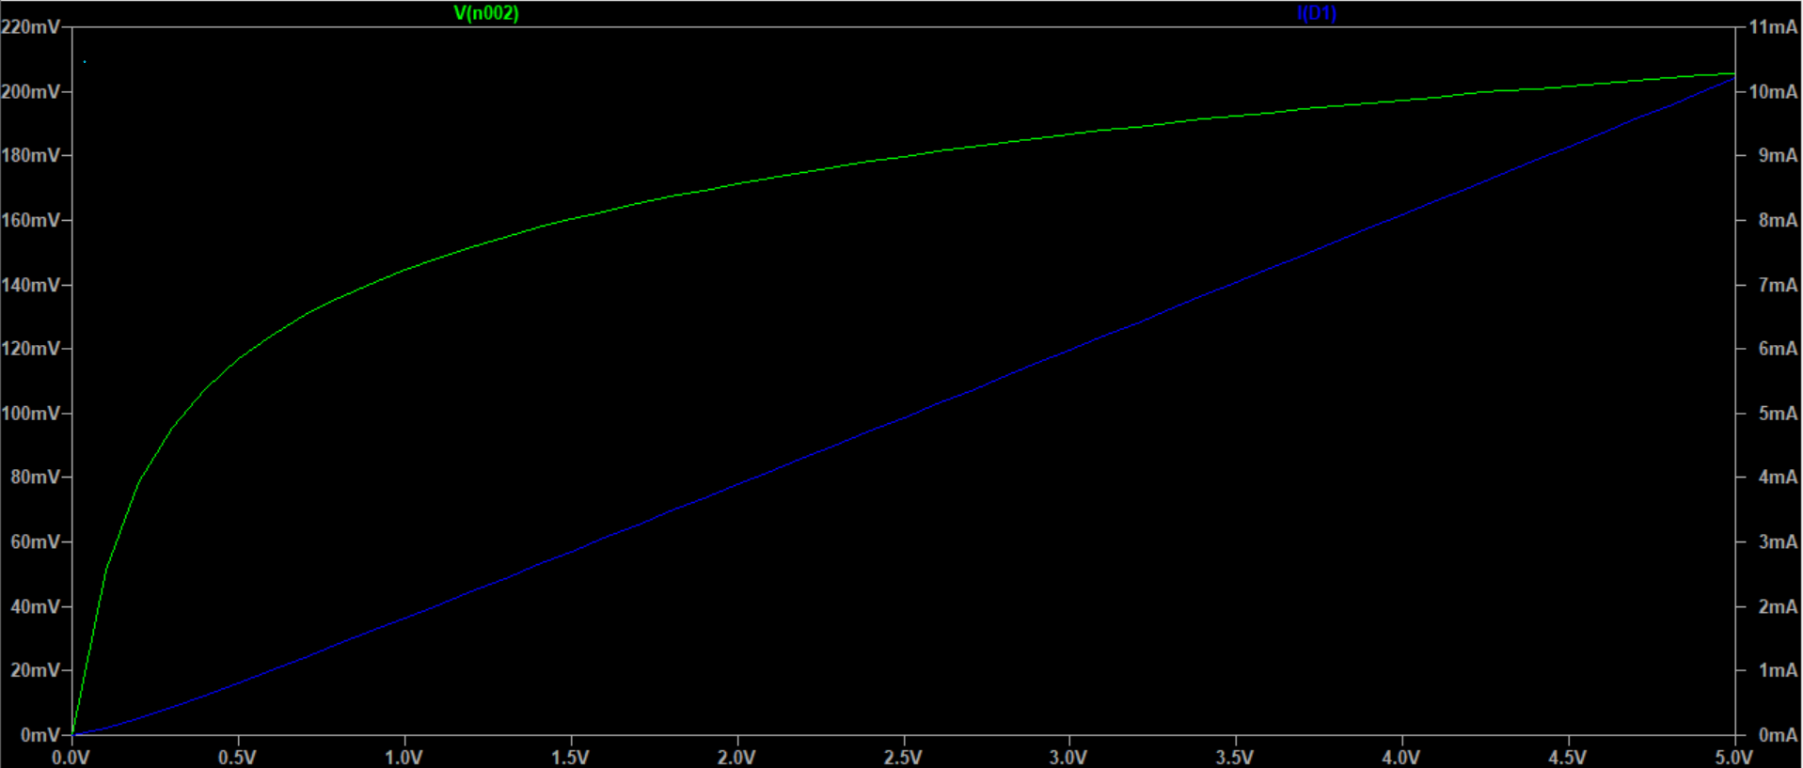
Exercise E4
bbbbb

